Slide 1
Introduction to deep transfer learning with Xfer
Andreas Damianou
Amazon, Cambridge UK

Slide 2
Outline
Deep neural networks quick reminder
Transfer learning intro
Xfer
Meta-learning
Considerations

Slide 3
Further Resources
Notebook: adamian.github.io/talks/Damianou_DL_tutorial_19.ipynb
Xfer: github.com/amzn/xfer/
Blog: link.medium.com/De5BXPJ9TT
A more complete tutorial on deep learning: adamian.github.io/talks/Damianou_deep_learning_rss_2018.pdf

Slide 4
Deep Neural Networks intro

Slide 5
Deep neural networks: hierarchical function definitions

Slide 6
Deep neural networks: hierarchical function definitions

Slide 7
Defining the Loss

Slide 8
Probabilistic re-formulation

Slide 9
Probabilistic re-formulation

Slide 10
Graphical depiction
W
W
W

Slide 11
Optimization

Slide 12

Derivative wrt
$$w_{1}$$

Slide 13

Derivative wrt
$$w_{0}$$

Slide 14
Optimization & Implementation
GOTO notebook!!

Slide 15
Automatic differentiation

Slide 16
Back to notebook!

Slide 17
Taming the dragon

Slide 19
“Tricks”
Smart initializations
ReLU: better behavior of gradients
Early stopping: prevent overfitting
Dropout
Batch-normalization
Transfer/meta-learning/BO: guide the training with another model
Many other “tricks”

Slide 27
Probabilistic re-formulation

Slide 34
Deep Gaussian processes. A. Damianou, N. Lawrence, 2013

Slide 35
Deep Gaussian processes. A. Damianou, N. Lawrence, 2013

Slide 36
Transfer Learning

Slide 37



Motivations for TL: DNN training requires expertise
Leveraging the power of DNNs even without too much expertise
import xfer
xfer.repurpose(model)
My gradients are exploding!

Slide 38
Motivations for TL: Leverage commonalities in data

Slide 39
Why does Transfer Learning work?

Slide 40
Back to our transfer example

Slide 41
Predictions using a pre-trained model (no transfer)
Predictions using Xfer

Slide 42
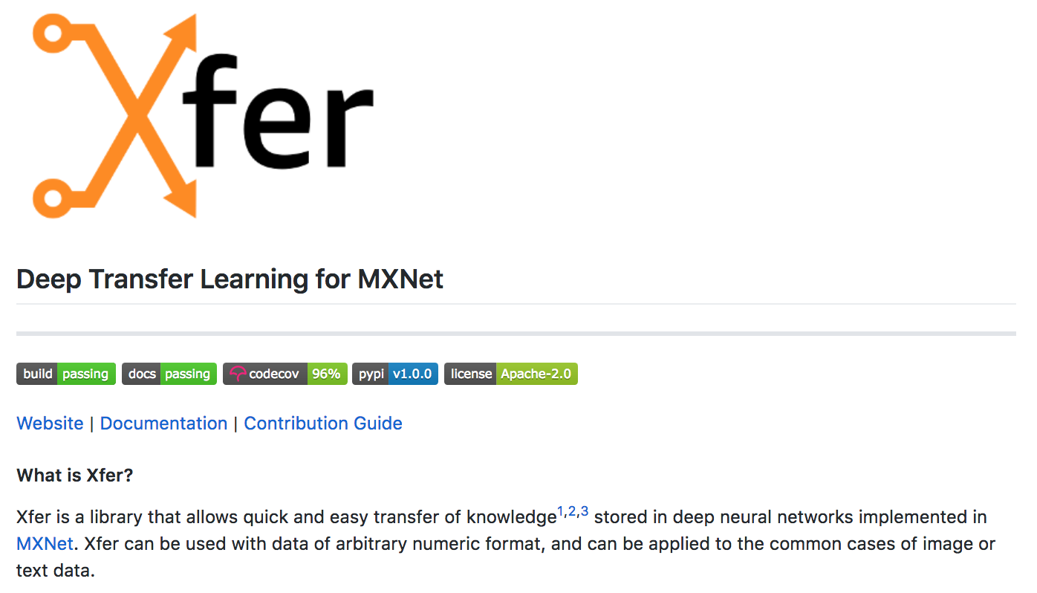
github.com/amzn/xfer

Slide 43
Xfer Repurposers
Source
(pre-trained) model
Repurposed model
Repurposer
Target data
Three kinds of repurposers:
Meta-model based
Fine-tuning based
Multi-task and meta-learning based (learning to learn)

Slide 44
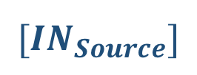

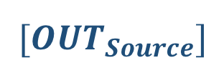
Meta-model based repurposing
Given: (source task)
$$[{OUT}_{Source}]$$
$$W$$
$$W$$
$$W$$
$$[{IN}_{Source}]$$
Notes:
Which layer to repurpose?

Slide 45

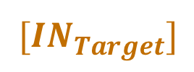




Meta-model based repurposing
Given: (source task)
Step 1: (target task)
$$[{OUT}_{Source}]$$
$$[{OUT}_{Target}]$$
$$W$$
$$W$$
$$W$$
$$W$$
$$W$$
$$W$$
$$[{IN}_{Source}]$$
$$[{IN}_{Target}]$$
Notes:
Which layer to repurpose?

Slide 46


Meta-model based repurposing
Given: (source task)
Step 1: (target task)
Step 2:
Meta-model
$$[{OUT}_{Source}]$$
$$[{OUT}_{Target}]$$
$$[OUT_{Target}]$$
$$W$$
$$W$$
$$W$$
$$W$$
$$W$$
$$W$$
$$[{IN}_{Source}]$$
$$[{IN}_{Target}]$$
Notes:
Which layer to repurpose?

Slide 47
Meta-model based repurposing
Given: (source task)
Step 1: (target task)
Step 2:
Meta-model
$$[{OUT}_{Source}]$$
$$[{OUT}_{Target}]$$
$$[OUT_{Target}]$$
$$W$$
$$W$$
GP, SVM,
LR, BNN …
$$W$$
$$W$$
$$W$$
$$W$$
$$[{IN}_{Source}]$$
$$[{IN}_{Target}]$$
Notes:
Which layer to repurpose?

Slide 48
Meta-model based repurposing
repurposer = xfer.LrRepurposer(source_model, feature_layer_names=['fc2','fc3’])
repurposer.repurpose(train_iterator)
predictions = repurposer.predict_label(test_iterator)

Slide 49
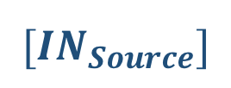


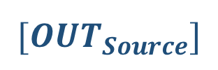
Fine-tuning based repurposing
Given
$$[{OUT}_{Source}]$$
$$W$$
$$W$$
$$W$$
$$[{IN}_{Source}]$$

Slide 50

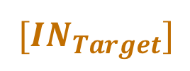

Fine-tuning based repurposing
Given
Refine
$$[{OUT}_{Source}]$$
$$[{OUT}_{Target}]$$
$$W$$
$$W$$
$$W$$
$$W$$
$$W$$
$$W$$
$$[{IN}_{Source}]$$
$$[{IN}_{Target}]$$
$$W$$

Slide 51


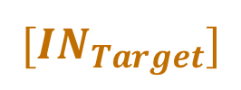

Fine-tuning based repurposing
Given
Refine
Fine-tune
$$[{OUT}_{Source}]$$
$$[{OUT}_{Target}]$$
$$[{OUT}_{Target}]$$
$$W$$
$$W$$
$$W$$
$$W$$
$$W$$
$$W$$
$$W$$
$$W$$
$$W$$
$$[{IN}_{Source}]$$
$$W$$
$$W$$
$$[{IN}_{Target}]$$
$$[{IN}_{Target}]$$

Slide 52
Fine-tuning based repurposing
mh = xfer.model_handler.ModelHandler(source_model)
conv1 = mxnet.sym.Convolution(name='convolution1', kernel=(20,20), num_filter=64) mh.add_layer_bottom([conv1])
mod = mh.get_module(iterator, fixed_layer_parameters=mh.get_layer_parameters(['conv1_1']),
random_layer_parameters=mh.get_layer_parameters(['fc6', 'fc7’]))
mod.fit(iterator, num_epoch=5)

Slide 53
Closer look at ModelHandler: inspection
mh = xfer.model_handler.ModelHandler(source_model)
print(mh.layer_names) print(mh.get_layer_type('relu5_2’)) print(mh.get_layer_names_matching_type('Convolution'))
mh.visualize_net()

Slide 54
Closer look at ModelHandler: feature extraction
features, labels = mh.get_layer_output(data_iterator= iterator, layer_names= ['fc6', 'fc8'])

Slide 55
Closer look at ModelHandler: model manipulation
mh.drop_layer_top(4)
mh.drop_layer_bottom(1)
conv1 = mx.sym.Convolution(name= 'convolution1', kernel=(20,20), num_filter=64) fc = mx.sym.FullyConnected(name= 'fullyconntected1', num_hidden= 4)
softmax = mx.sym.SoftmaxOutput(name = 'softmax’)
mh.add_layer_bottom([conv1])
mh.add_layer_top([fc, softmax])

Slide 56
Custom repurposers
class KNNRepurposer(xfer.MetaModelRepurposer):
def __init__(...):
super(KNNRepurposer, self).__init__(...)
def _train_model_from_features(...):
lin_model = KNeighborsClassifier(n_neighbors=self.n_neighbors,...)
...
def _predict_probability_from_features(): ...
def _predict_label_from_features(): ...
def get_params(self): ...
def serialize(self, file_prefix): ...
https://xfer.readthedocs.io/en/master/demos/xfer-custom-repurposers.html

Slide 57
Custom repurposers
class Add2FullyConnectedRepurposer(xfer.NeuralNetworkRepurposer):
...
def _create_target_module(self, train_iterator: mx.io.DataIter):
model_handler = xfer.model_handler.ModelHandler(self.source_model, ...)
# ModelHandler functionality goes here...
return model_handler.get_module(train_iterator, fixed_layer_parameters= conv_layer_params)
https://xfer.readthedocs.io/en/master/demos/xfer-custom-repurposers.html

Slide 58


Reminder: fine-tuning based repurposing
$$[{OUT}_{Target}]$$
$$W$$
Weights from pre-trained
source model
$$W$$
$$W$$
New weights
$$W$$
$$[{IN}_{Target}]$$

Slide 59
Reminder: fine-tuning based repurposing
$$[{OUT}_{Target}]$$
$$W$$
What learning rate to use for pre-trained vs new weights?
How many epochs?
What optimizer to use?
Weights from pre-trained
source model
$$W$$
$$W$$
New weights
$$W$$
$$[{IN}_{Target}]$$

Slide 60
HPO for hyperparameter tuning
optimizer_id_to_name = {1: 'sgd', 2:'adam’}
domain_with_2_hyperparams =
[{'name': 'learning_rate', 'type': 'continuous', 'domain': (0,1)},
{'name': 'optimizer', 'type': 'discrete', 'domain': (1,2)}]
hyperparameter_optimizer2 = GPyOpt.methods.BayesianOptimization(
f = hpo_objective_function,
domain = domain_with_2_hyperparams))
hyperparameter_optimizer2.run_optimization()
https://xfer.readthedocs.io/en/master/demos/xfer-hpo.html

Slide 61
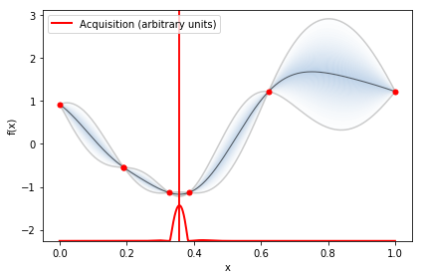
hyperparameter_optimizer.plot_acquisition()

Slide 62
Xfer with Gluon
Gluon models can be used with Xfer provided they use HybridBlocks so that the symbol can be extracted.
net = gluon.nn.HybridSequential()
…
net.hybridize()
Notes:
The second block can be replaced with a serialize gluon and load in symbol.

Slide 63
Xfer with Gluon
Gluon models can be used with Xfer provided they use HybridBlocks so that the symbol can be extracted.
net = gluon.nn.HybridSequential()
…
net.hybridize()
The Gluon model (block) is then converted into a model (symbol)
sym = block(data)
args, auxs = block2symbol(block.collect_params())
model = symbol2model(sym, data)
model.set_params(args, auxs)
Notes:
The second block can be replaced with a serialize gluon and load in symbol.

Slide 64
Transfer through meta-learning
Learning to learn
Related to multi-task learning
Our approach: transfer knowledge across learning processes
Transfer learning in a higher level of abstraction
Transfer learning among typically many tasks
All task sub-models act as source and target models

Slide 65
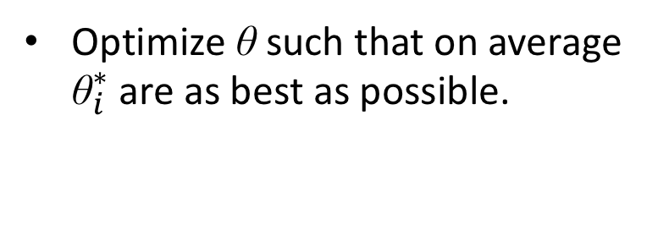
Meta-learning or multi-task learning
θ : global initialization
Optimize θ such that on average ${\text{θ}}_{i}^{∗}$ are as best as possible.
MAML approach by Chelsea Finn et al. 2017
Notes:
MAML: \theta \leftarrow \theta - \beta \nabla_\theta \sum_{\tau_i \sim p(\tau)} L_{\tau_i} \left[ f \left( \theta' - \alpha \nabla_{\theta'} L_{\tau_i}f(\theta') \right) \right]

Slide 66
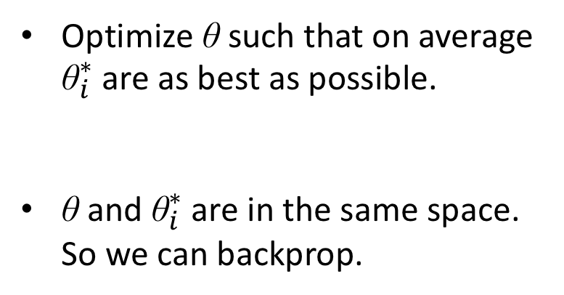
Meta-learning or multi-task learning
θ : global initialization
Optimize θ such that on average ${\text{θ}}_{i}^{∗}$ are as best as possible.
θ and ${\text{θ}}_{i}^{∗}$ are in the same space. So we can backprop.
MAML approach by Chelsea Finn et al. 2017
Notes:
MAML: \theta \leftarrow \theta - \beta \nabla_\theta \sum_{\tau_i \sim p(\tau)} L_{\tau_i} \left[ f \left( \theta' - \alpha \nabla_{\theta'} L_{\tau_i}f(\theta') \right) \right]

Slide 67
Meta-learning or multi-task learning
θ : global initialization
Optimize θ such that on average ${\text{θ}}_{i}^{∗}$ are as best as possible.
θ and ${\text{θ}}_{i}^{∗}$ are in the same space. So we can backprop.
MAML approach by Chelsea Finn et al. 2017
Notes:
MAML: \theta \leftarrow \theta - \beta \nabla_\theta \sum_{\tau_i \sim p(\tau)} L_{\tau_i} \left[ f \left( \theta' - \alpha \nabla_{\theta'} L_{\tau_i}f(\theta') \right) \right]

Slide 68
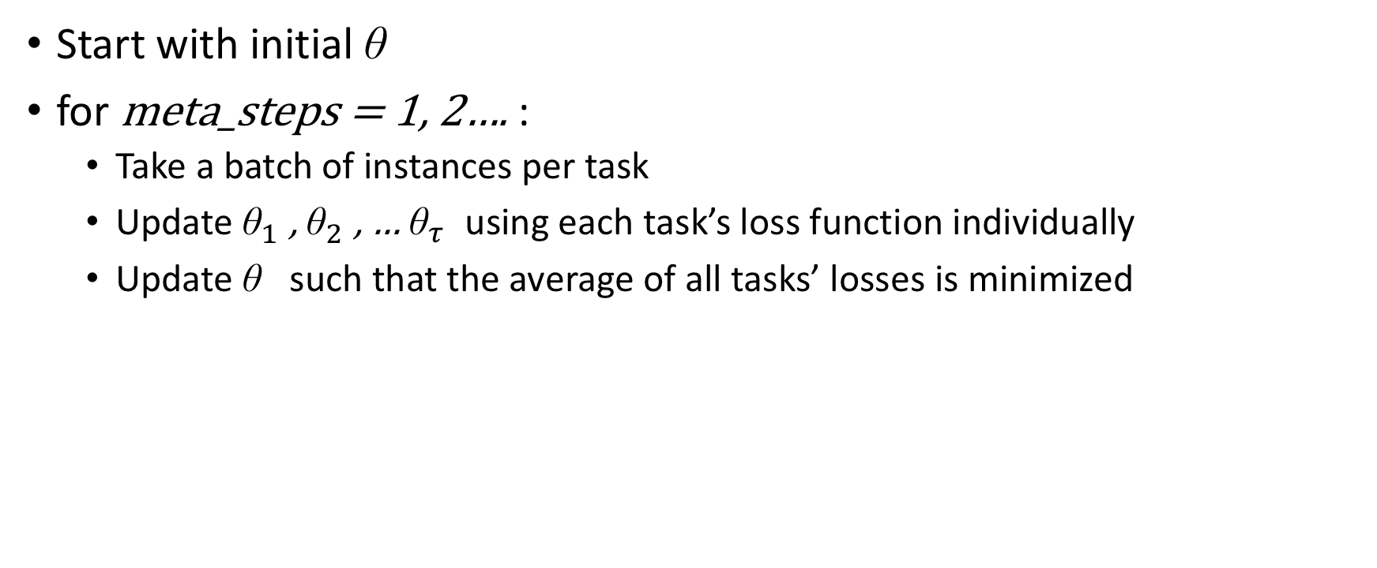
Start with initial ${\text{θ}}_{}^{}$
for meta_steps = 1, 2…. :
Take a batch of instances per task
Update ${\text{θ}}_{1}^{}$, ${\text{θ}}_{2}^{}$, … ${\text{θ}}_{τ}^{}$ using each task’s loss function individually
Update ${\text{θ}}_{}^{}$such that the average of all tasks’ losses is minimized

Slide 69
Meta-learning or multi-task learning
θ : global initialization
Optimize θ such that on average ${\text{θ}}_{i}^{∗}$ are as best as possible.
θ and ${\text{θ}}_{i}^{∗}$ are in the same space. So we can backprop.
MAML approach by Chelsea Finn et al. 2017
Notes:
MAML: \theta \leftarrow \theta - \beta \nabla_\theta \sum_{\tau_i \sim p(\tau)} L_{\tau_i} \left[ f \left( \theta' - \alpha \nabla_{\theta'} L_{\tau_i}f(\theta') \right) \right]

Slide 70
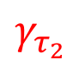
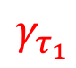
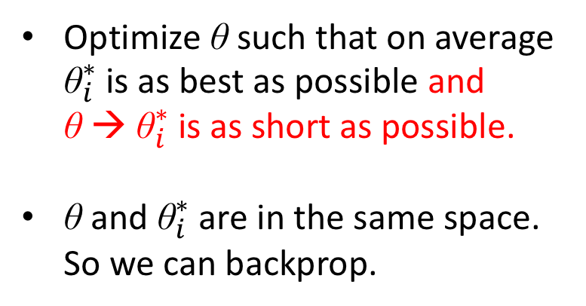
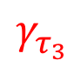
Meta-learning or multi-task learning
θ : global initialization
Optimize θ such that on average ${\text{θ}}_{i}^{∗}$ is as best as possible and θ → ${\text{θ}}_{i}^{∗}$ is as short as possible.
θ and ${\text{θ}}_{i}^{∗}$ are in the same space. So we can backprop.
$$γ_{τ_{1}}$$
$$γ_{τ_{3}}$$
$$γ_{τ_{2}}$$
Leap approach by Flennerhag et al. 2019
(in Xfer soon!)
Notes:
MAML: \theta \leftarrow \theta - \beta \nabla_\theta \sum_{\tau_i \sim p(\tau)} L_{\tau_i} \left[ f \left( \theta' - \alpha \nabla_{\theta'} L_{\tau_i}f(\theta') \right) \right]

Slide 71
Leap balances gradient paths from all tasks…
… to minimize the expected gradient path.
Meta-step 1
Meta-step 2

Slide 72
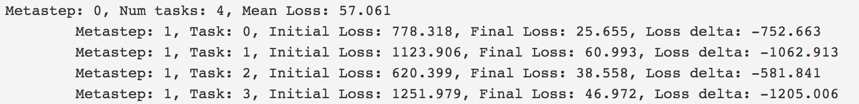
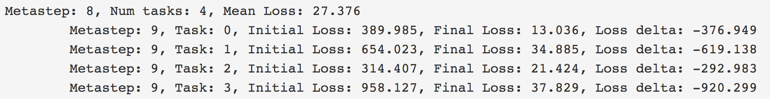
Xfer meta-learning (available soon!)
import xfer.contrib.xfer_leap as leap
lmr = leap.leap_meta_repurposer.LeapMetaRepurposer(model, num_meta_steps, num_epochs)
lmr.repurpose(train_data_all)

Slide 73
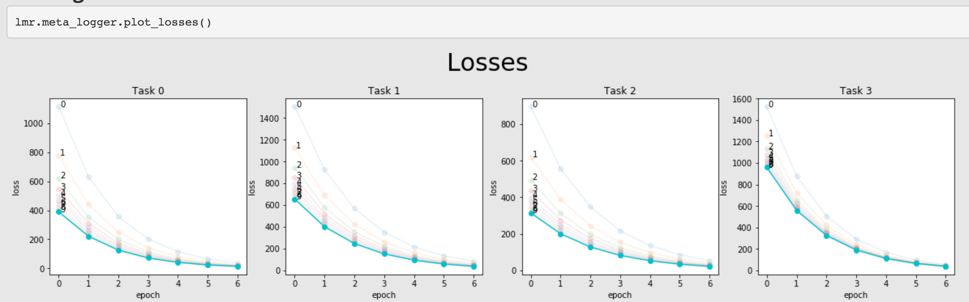

Slide 75
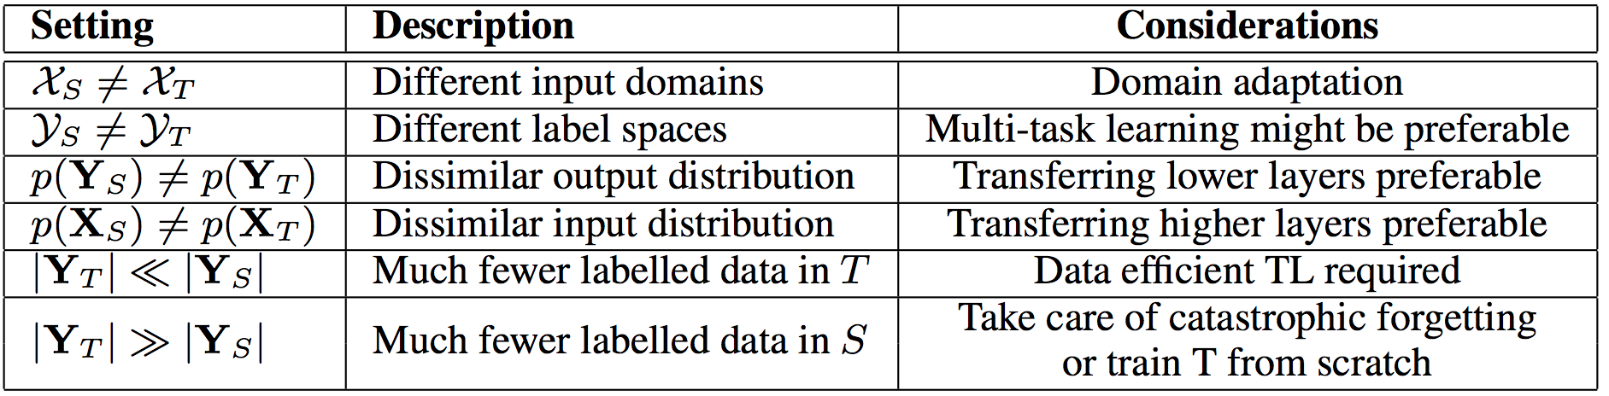
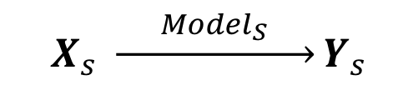
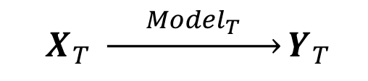
Data properties considerations
Source task:
$$X_{s} \underset{→}{{ Model}_{S} }Y_{s}$$
Target task:
$$X_{T} \underset{→}{{ Model}_{T} }Y_{T}$$
Transfer learning: Use ${Model}_{S}$ to improve ${Model}_{T}$

Slide 76
Conclusions
NNs are mathematically simple; challenge is how to optimize them.
Data efficiency? Uncertainty Calibration? Interpretability? Safety?
Bayesian NNs solve some of the above.
Repurposing neural networks is more practical.
Xfer: library for automatic repurposing

Slide 77
Acknowledgements
Jordan Massiah
Keerthana Elango
Pablo Garcia Moreno
Nikos Aletras
Sebastian Flennerhag

Slide 78
Further Resources
Notebook: adamian.github.io/talks/Damianou_DL_tutorial_19.ipynb
Xfer: github.com/amzn/xfer/
Blog: link.medium.com/De5BXPJ9TT
A more complete tutorial on deep learning: adamian.github.io/talks/Damianou_deep_learning_rss_2018.pdf

